Slide 1
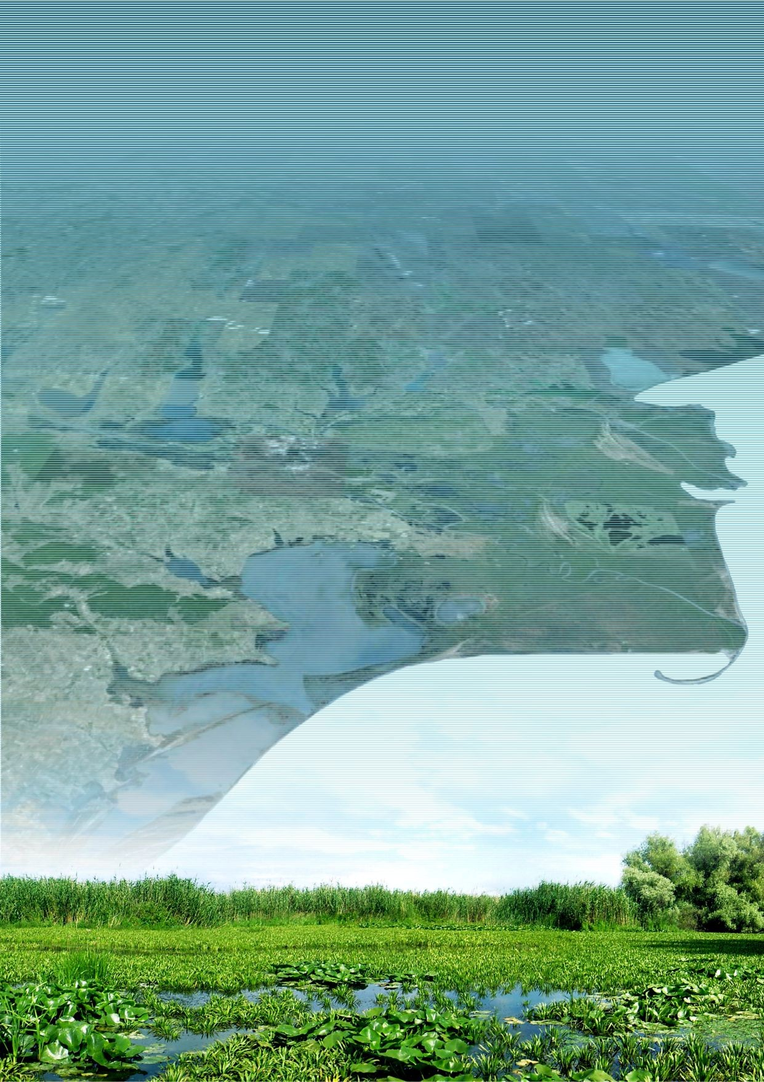




The History and Future of Wetlands Health
100 Years of Research
for Sustainable Management
in the Danube Delta
1926 - 2026
THE XXXIII-rd
DDNI SCIENTIFIC EVENT COMMUNITY
TULCEA, MAY 12 - 13, 2026
Sponsor:
Agenda:

